Slide 1

Parallel Deep Learning Neural Networks and GAN to detect features on CelebFaces Dataset
Hemant Jain
NU ID : 001305974
Spring 2021
Team - 5

Slide 2
The Dataset
The dataset is a celebrity image dataset that is created by the researchers of MMLAB. The dataset contains 202599 images of different celebrities. When downloaded and unzipped, the dataset consists of:
Img_align_celeba: Folder containing all the images
List_eval_partition.csv: Has images partitioned according to train(0), validation(1) and test(2)
List_box_celeba.csv: Bounding box values for eyes and mouth
List_and_mark_align_celeba.csv: Image landmarks
List_attr_celeba.csv: Has a list of 40 attributes for each image

Slide 3
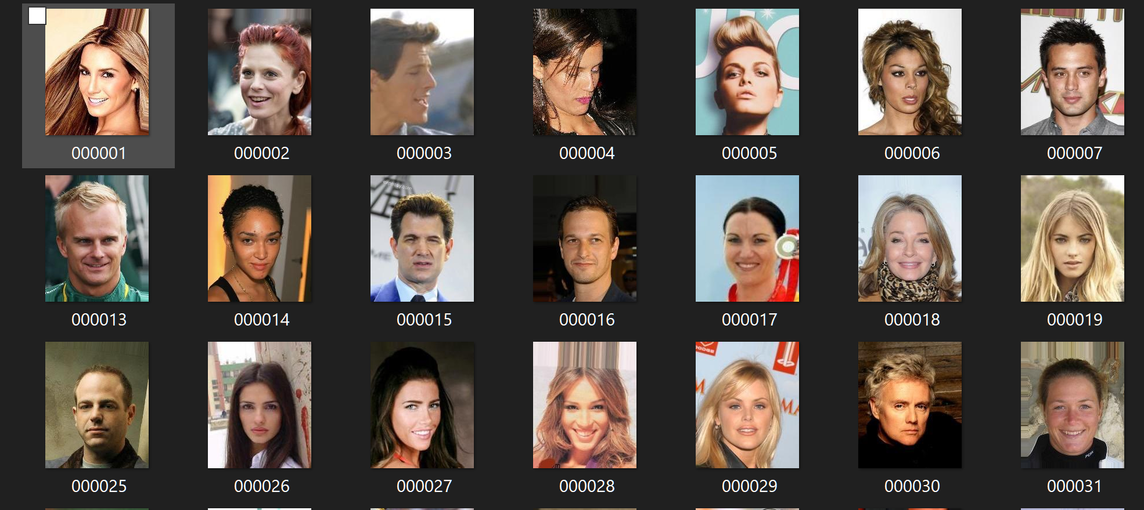
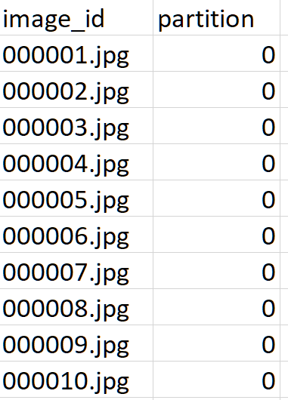
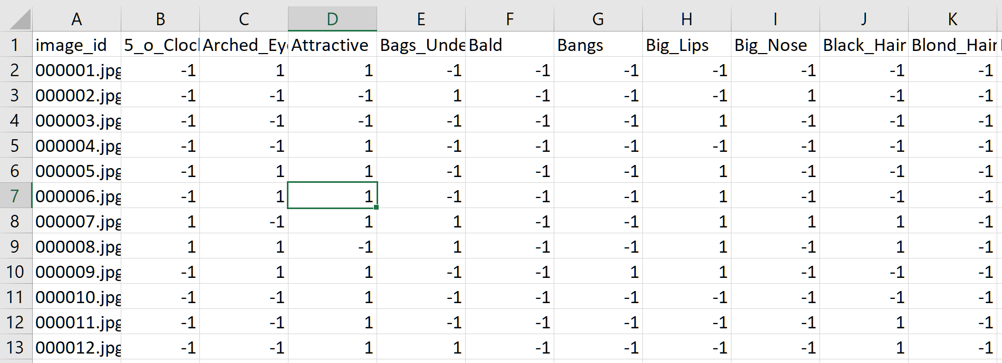
What I will be using...
3) Partition csv
1) Image folder
2) Attributes csv file

Slide 4
Problem Statement
1) To construct CNN’s to Differentiate features among images:
Creating a model that can predict the gender of the person in the image between male and female
b) A model that can predict the hair color of the person in the image
2) Creating a GAN architecture to generate new faces using image data
3) Deploying the Fake Face Generation Web Application on Streamlit

Slide 5
Approach
I will be using Pytorch’s torchvision with a gpu backend and CUDA
Pytorch is our framework of choice as it has easy data parallelism and is used more widely.

Slide 6
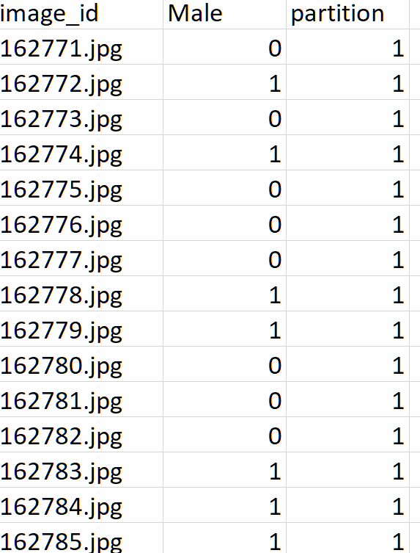
Part 1 : CNN for Gender Prediction
Data Cleaning
All unwanted features were removed
The values for -1 were converted to 0
It was combined with the partition csv
Divided into 3 separate csv according to train, validation, and test

Slide 7
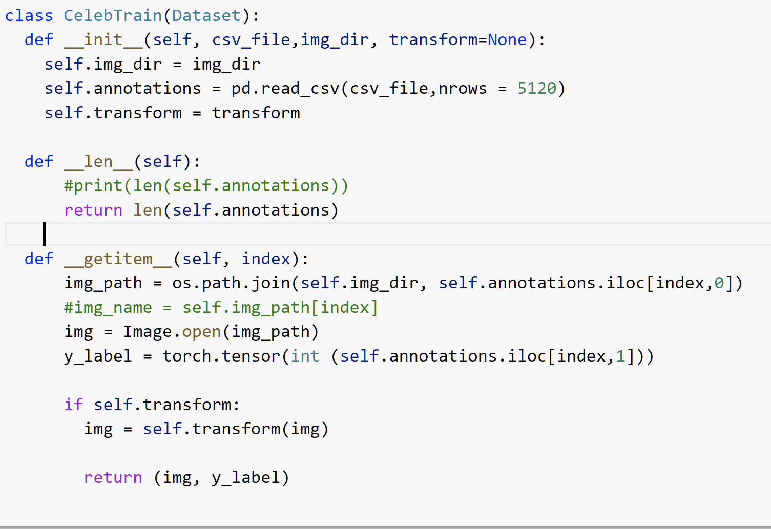
2. Creating a custom dataset class
Used to join the images in the directory to the csv folder
Has three primary functions __init__, __len__, __getitem__
Returns each image with the label i.e 0 if female and 1 if male

Slide 8
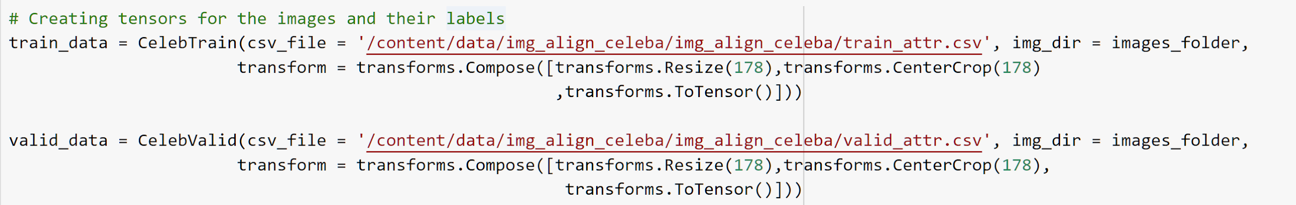
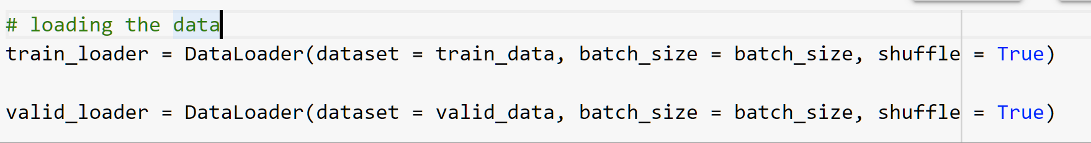
3. Loading the Data
Image is transformed so that all images have same dimensions
It is next converted into a tensor for pytorch to read
Sent to the data loader with a batch size of 128

Slide 9
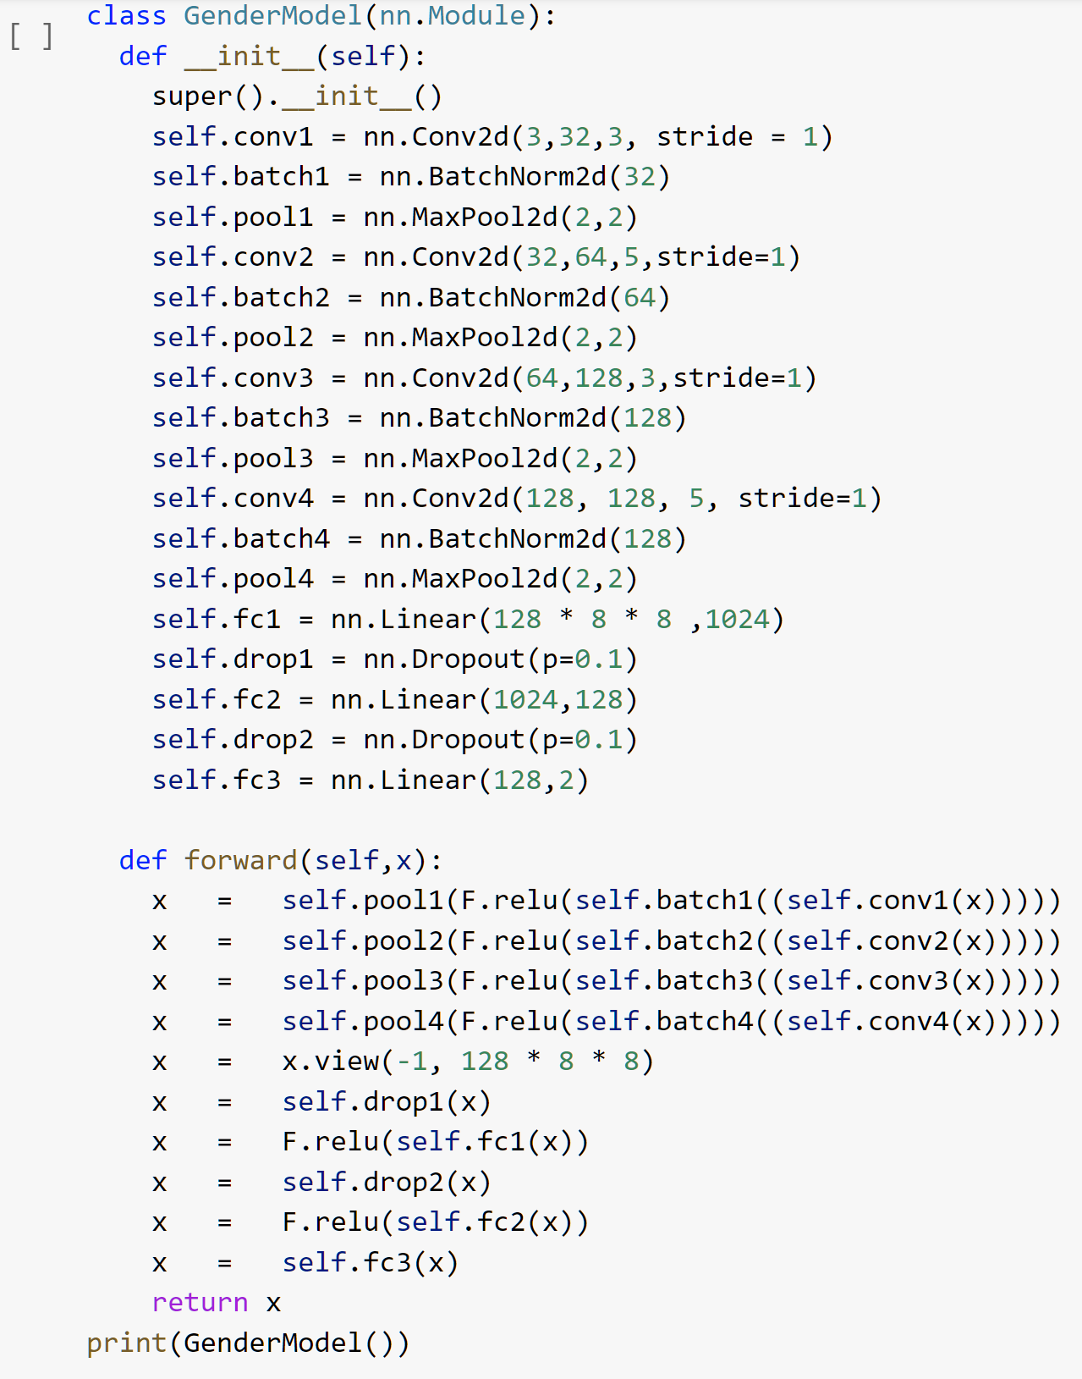
4. CNN Architecture
Model consists of 4 convolutional layers
Max pooling used to reduce dimensionality
Batch Normalization used to quicken learning and to ensure each layers nodes are learning better
Dropout used to ensure no bias on any nodes in particular
ReLu used as activation function as it is more computationally efficient and has better convergence

Slide 10
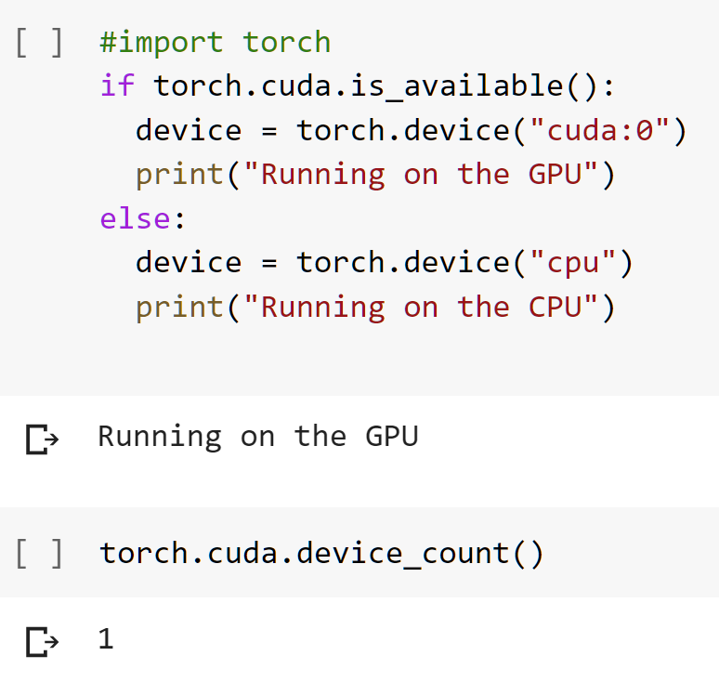
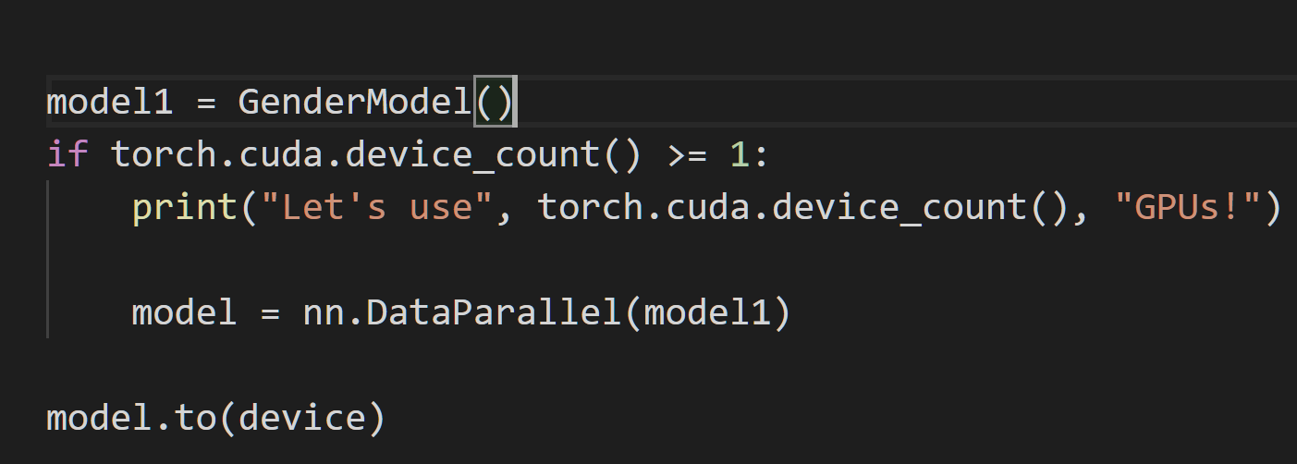
5. Data Parallelism
For using GPUS I first make sure I have GPUs available and then check how many are available:
For using data parallelism I use the above code to ensure I am using all the available GPU’s to improve the speed of our training
Here the model is pushed to the GPU and the nn.DataParallel divides the task among all available GPU’s
Here I have only 1 GPU

Slide 11
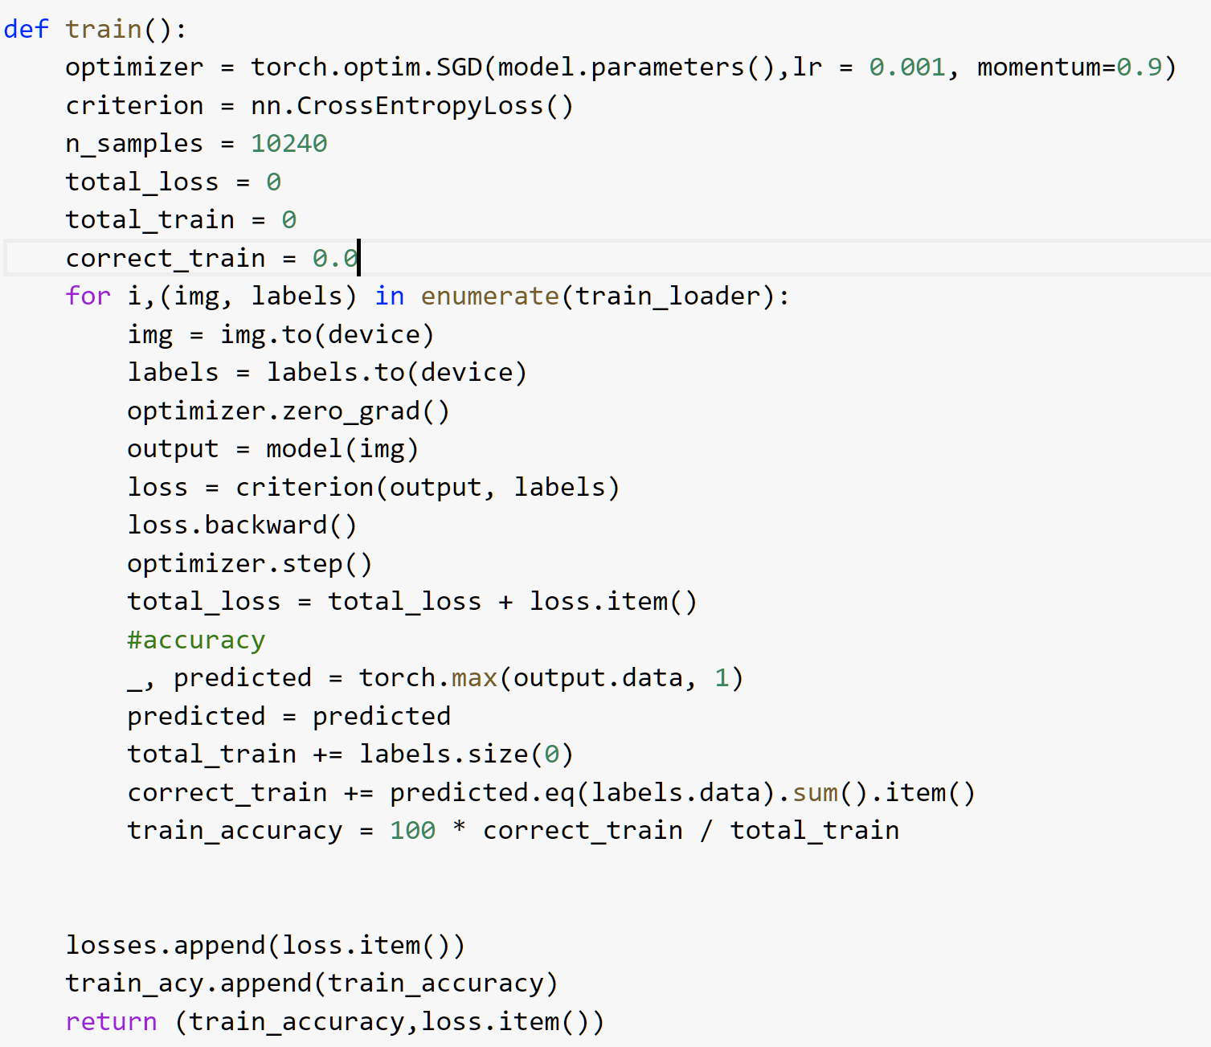
6. Creating training function
Optimizer used is SGD
CrossEntropy used which is a combination of LogSoftmax() and NLLLoss()
Computation done on gpu
Loss and accuracy of model for each epoch is calculated and returned.

Slide 12
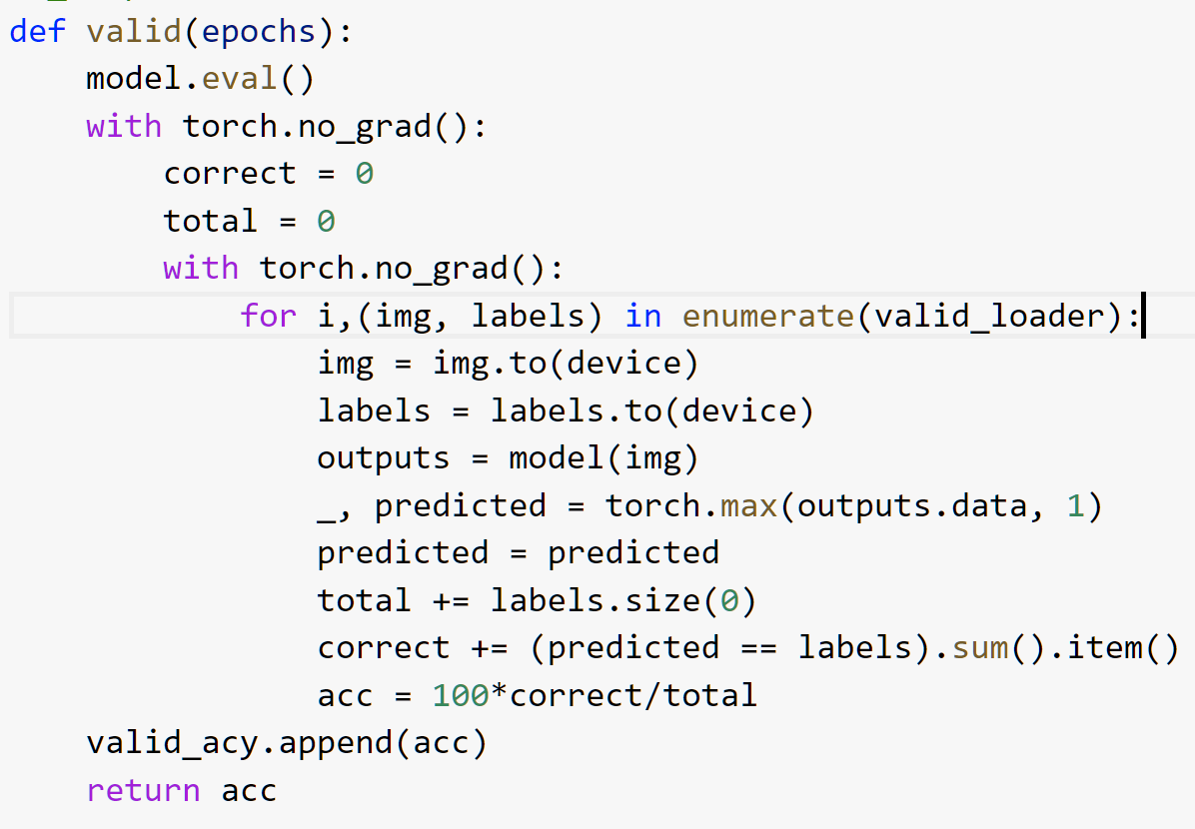
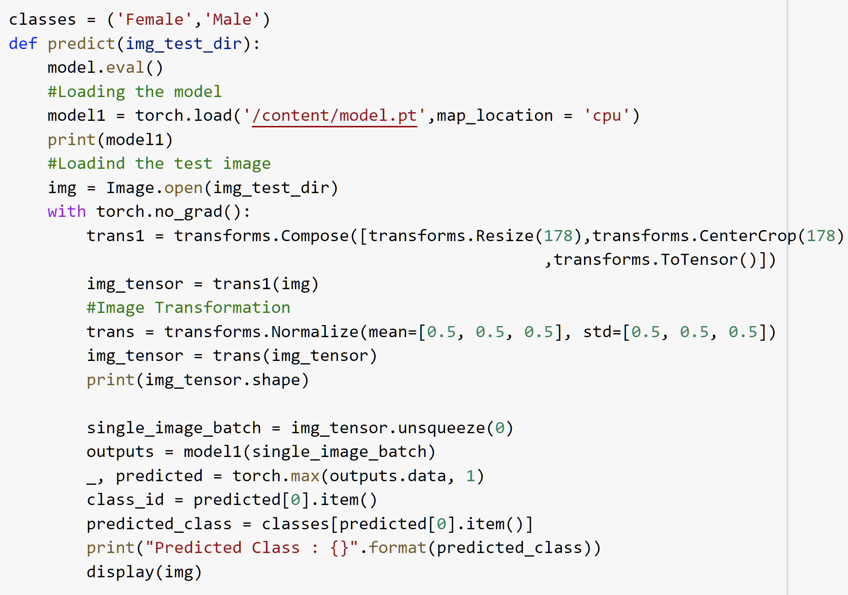
7. Validation and Testing functions
For each epoch in validation, the accuracy is calculated and returned.
No changes are made to the weights of the model based on validation
Transforms each image first, then predicts the image label from the image test photos.

Slide 13
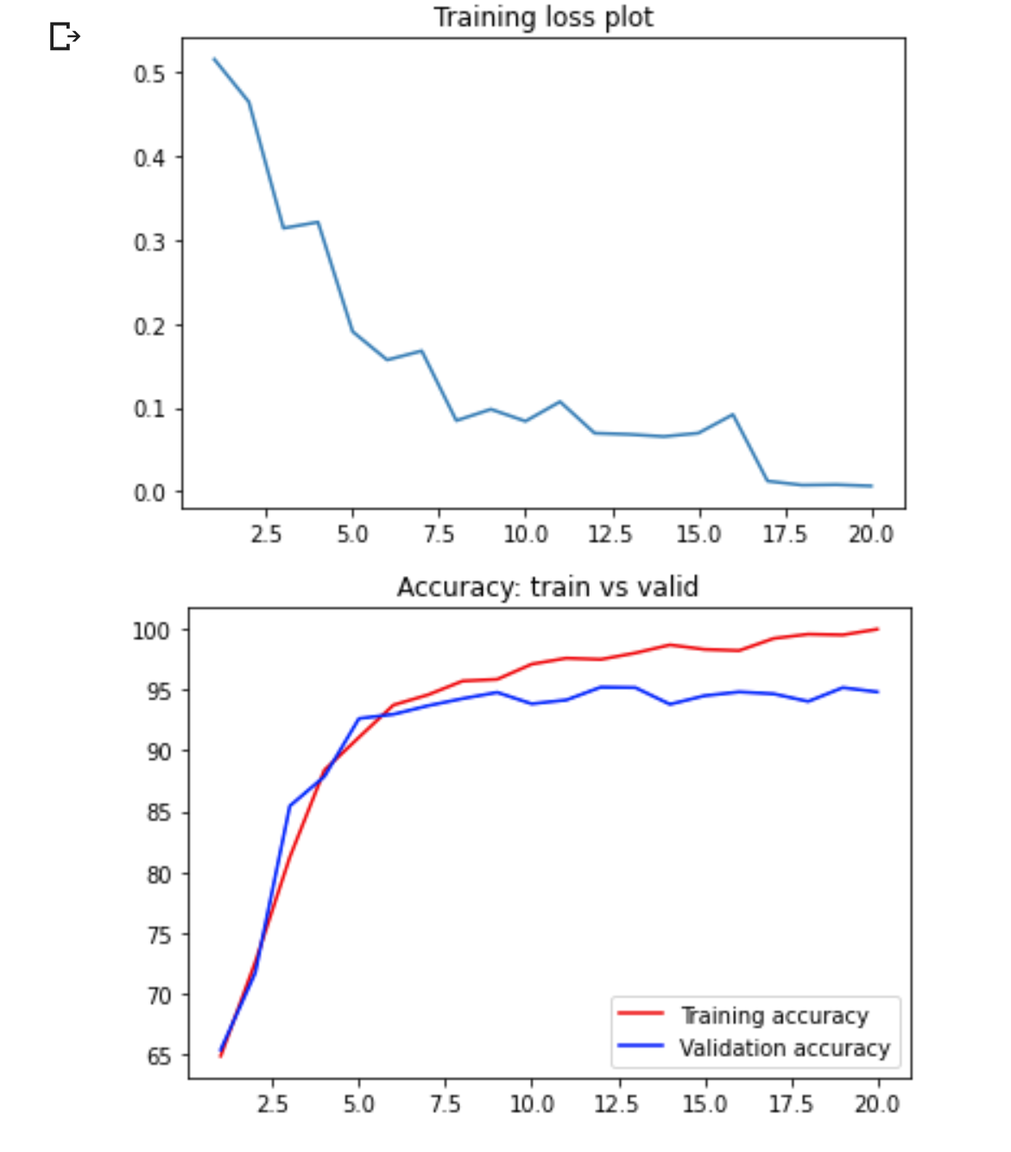
8. Model Results
The model has a training loss that drops to under 0.1 in 20 epochs.
The training accuracy increases over each epoch and almost touches 99%.
The validation accuracy though flatlines after around 8 epochs.
This indicates the model isn’t learning any new features and starts to overfit the training data after 8 epochs.

Slide 14
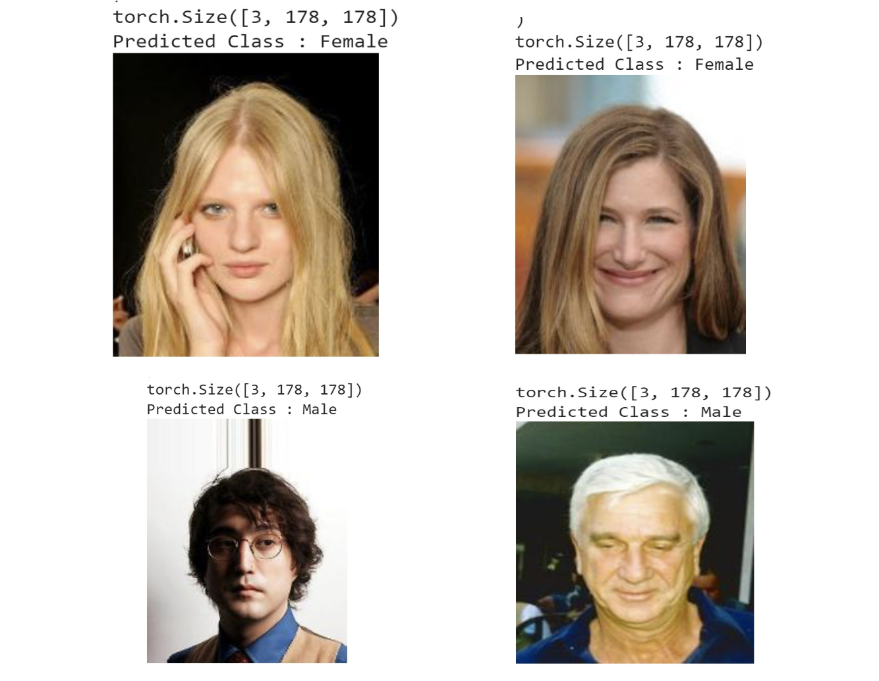
9. Predicting on test images
The model can accurately predict the gender based on the test images.

Slide 15
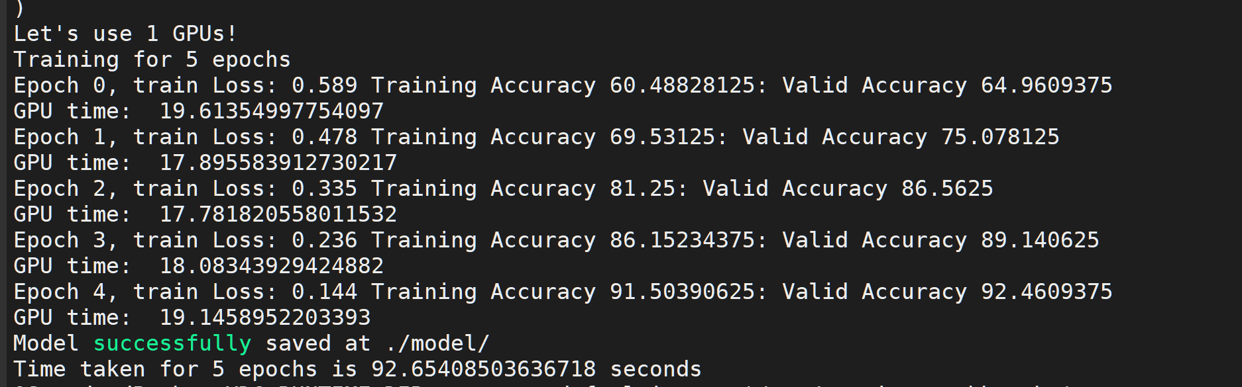
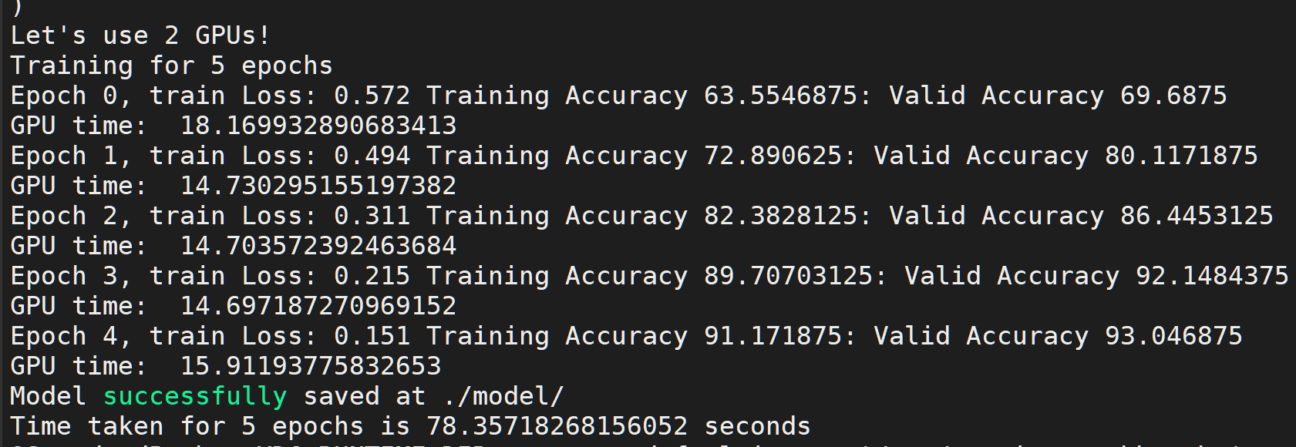
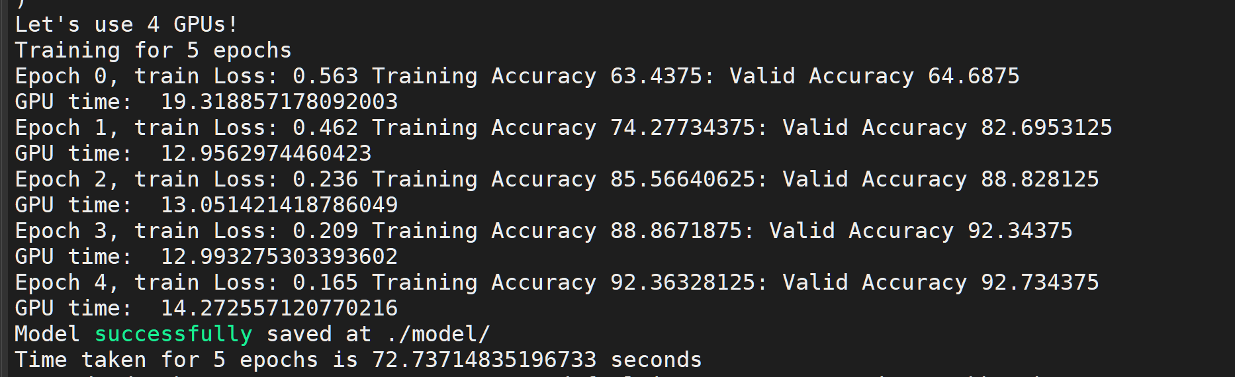
10. Data Parallelism results

Slide 16
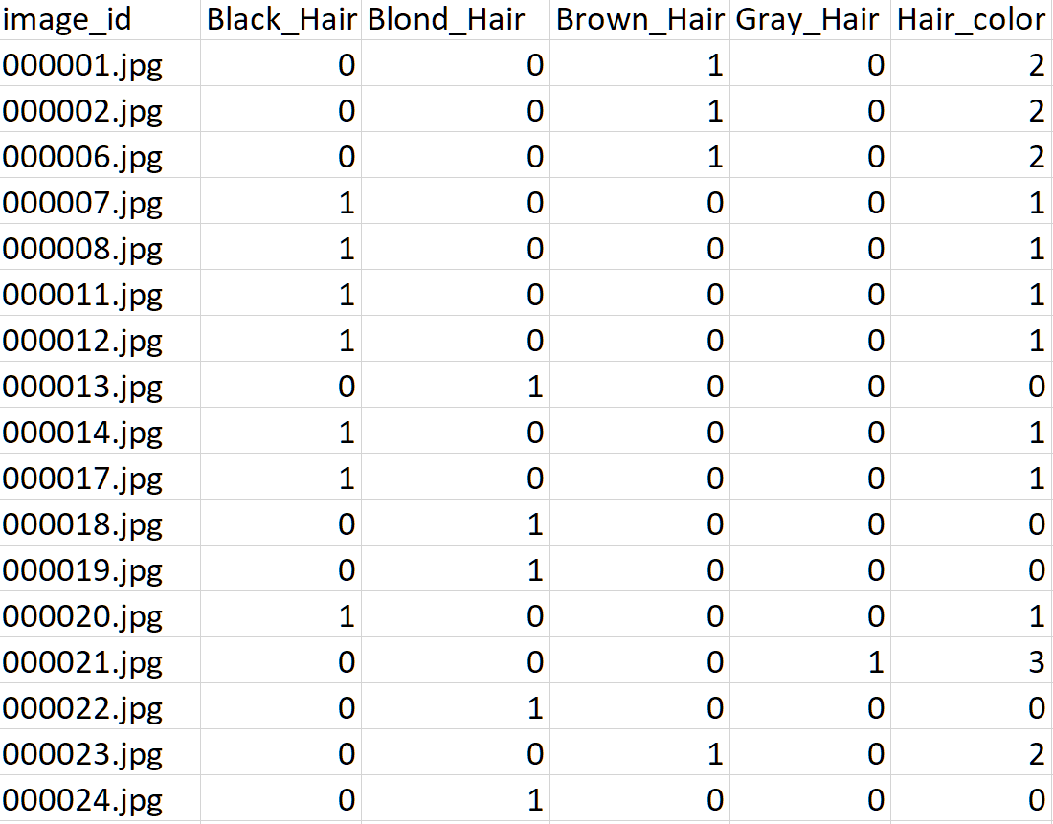
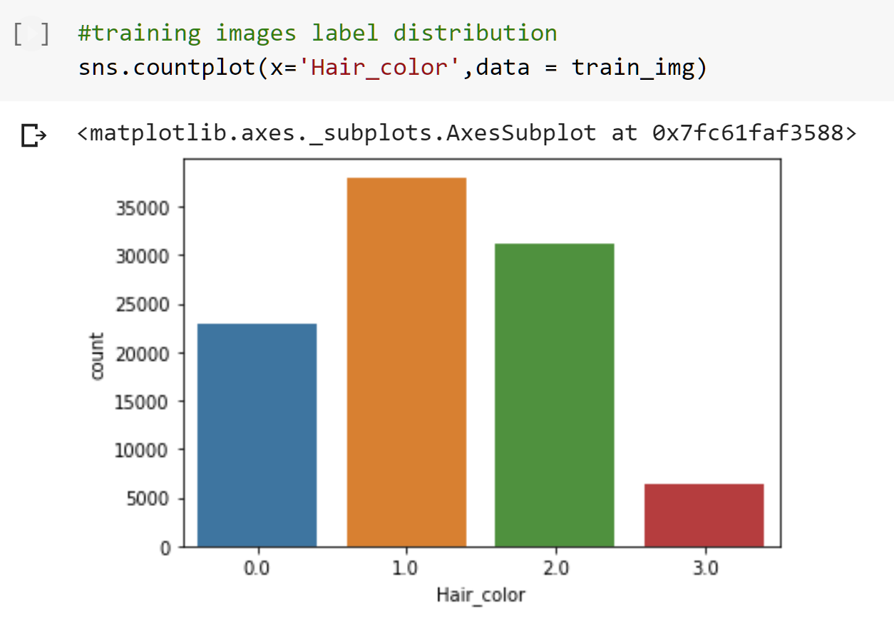
Part 2: CNN for Hair Color Prediction
1. Data Cleaning
Hair Color features were included and rest were dropped
New target column was created, using pandas, and all hair color
Values were assigned.
0 = Blond Hair
1 = Black Hair
2 = Brown Hair
3 = Gray Hair
Many rows had zero values for all rows among hair colour, these rows were dropped along with all empty rows

Slide 17
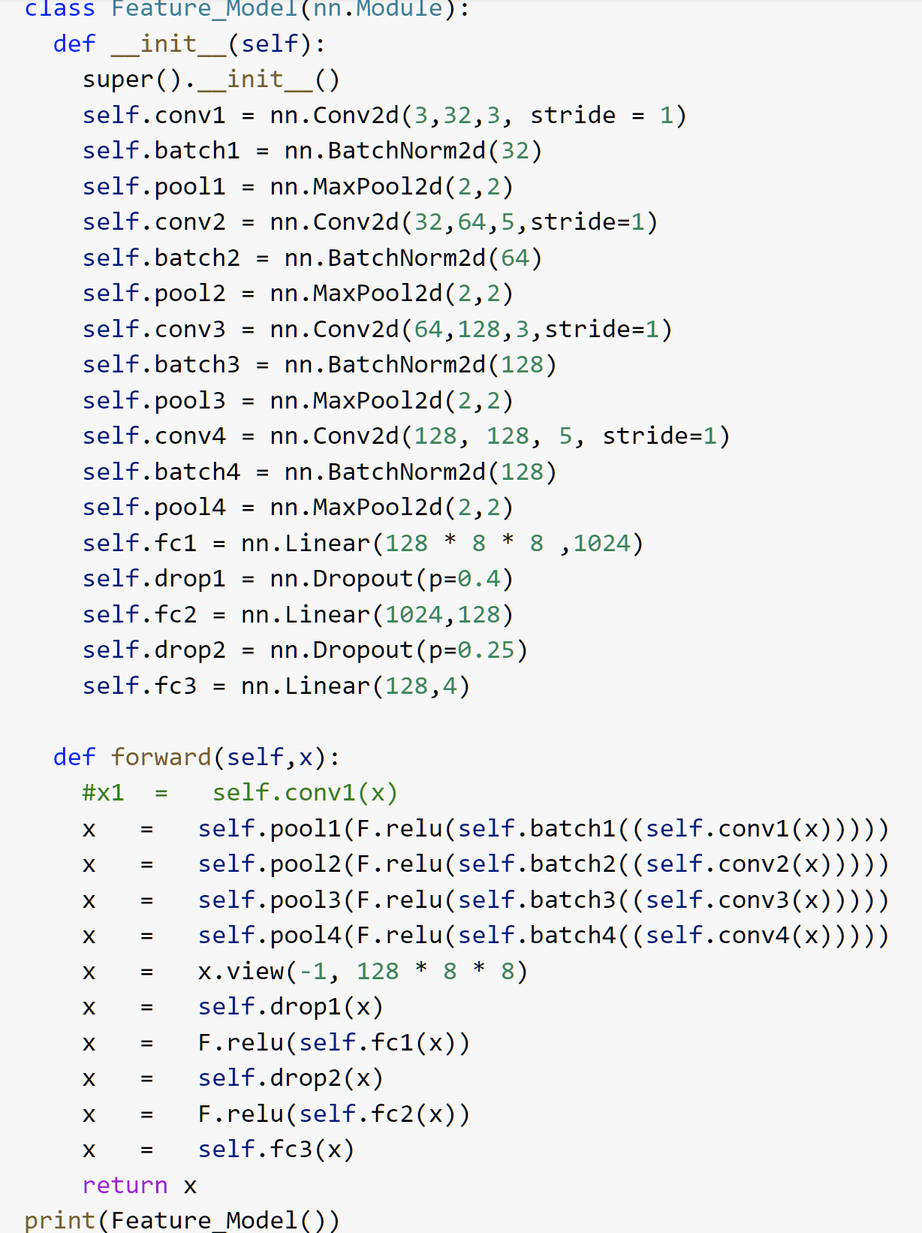
2. Model architecture
The hair color prediction steps for dataset and loading data is similar to that for gender prediction
The model uses 4 convolutional 2D layers, Maxpooling, Batch Normalization and Dropout

Slide 18
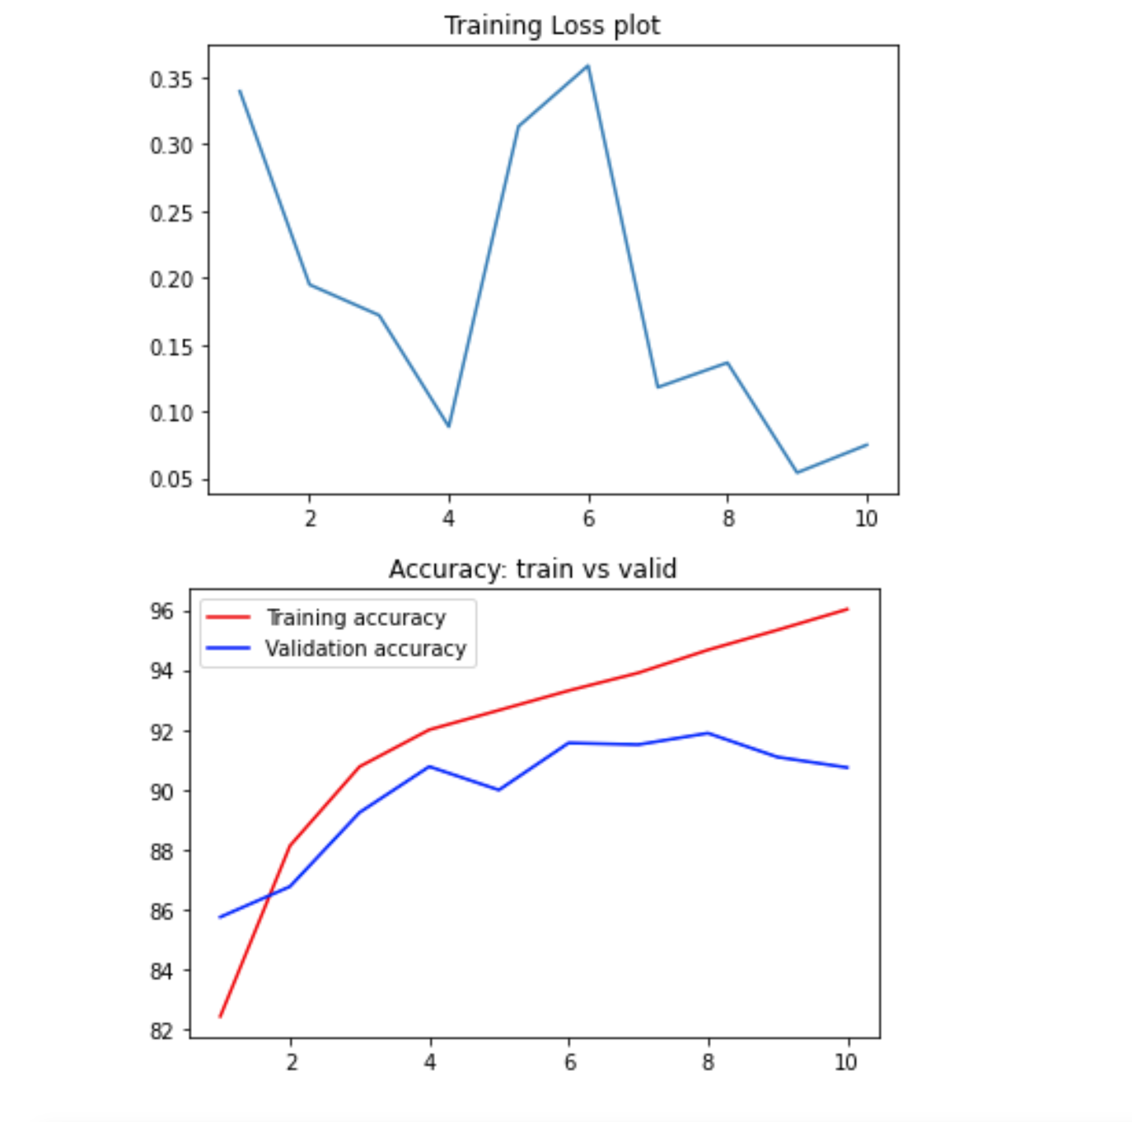
3. Results
The loss for the Hair Feature model is seen to vary a little but drops significantly.
The training accuracy is seen to be very high reaching close to 96% while the Validation accuracy is seen to flatline after 6 epochs thus indicating that the model starts to overfit the training data.
This was seen to reduce after introducing regularization such as dropout

Slide 19
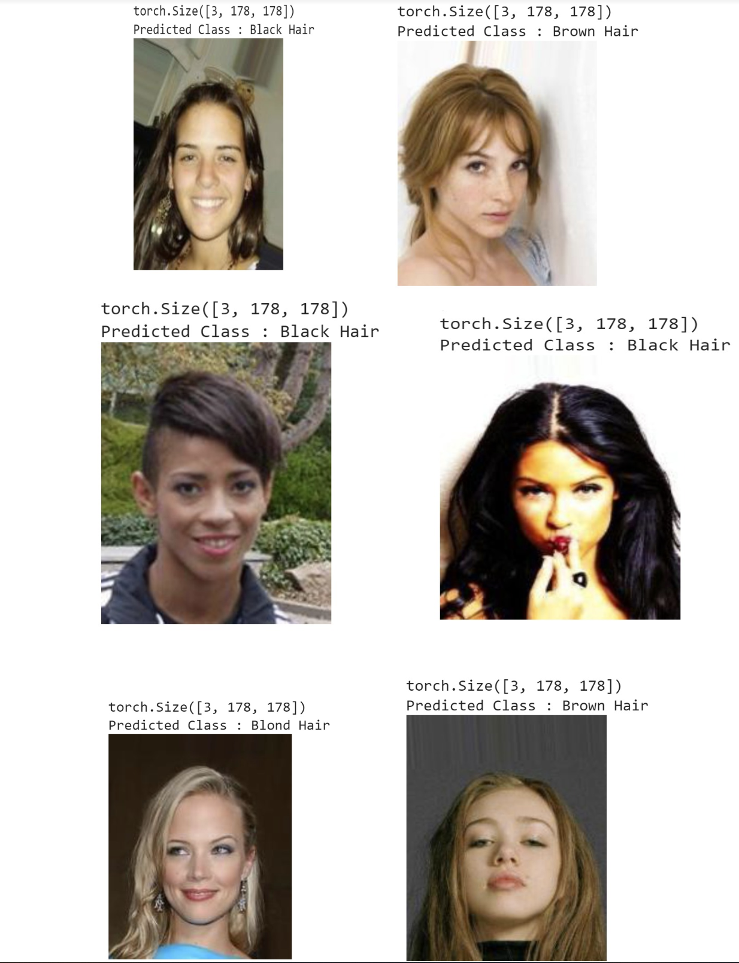
4. Predicting image labels

Slide 20
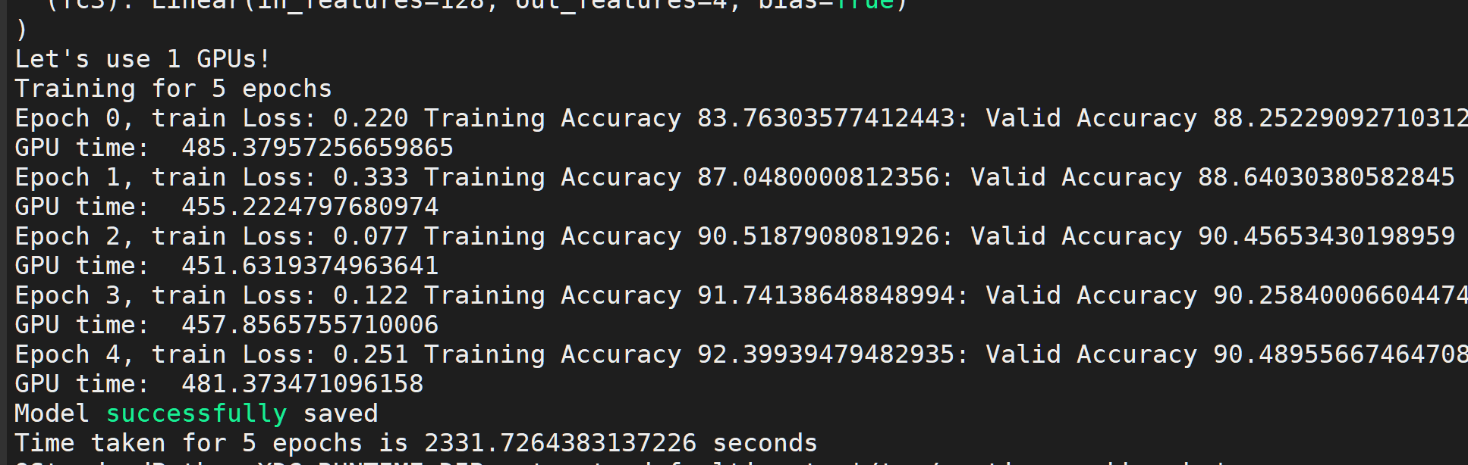
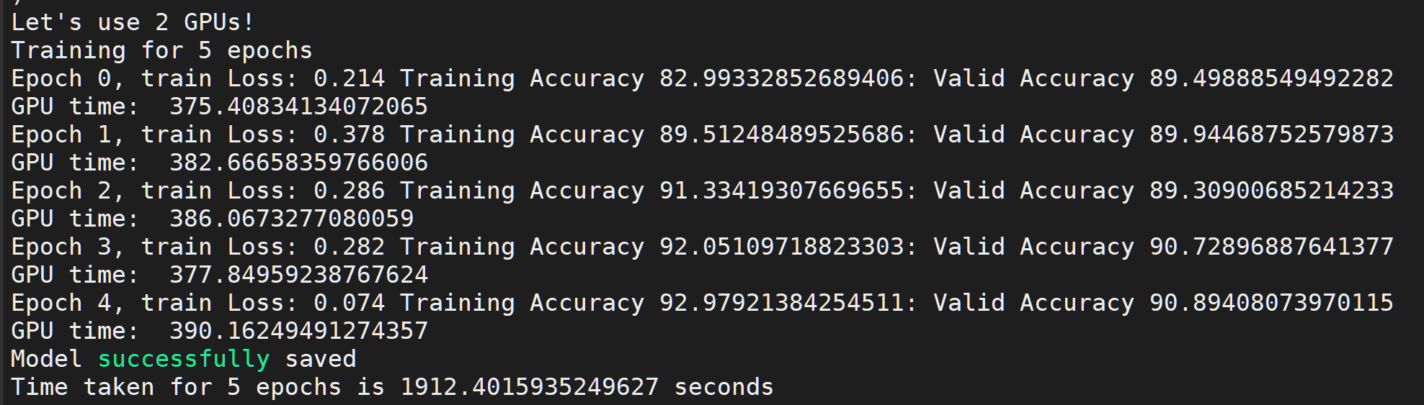
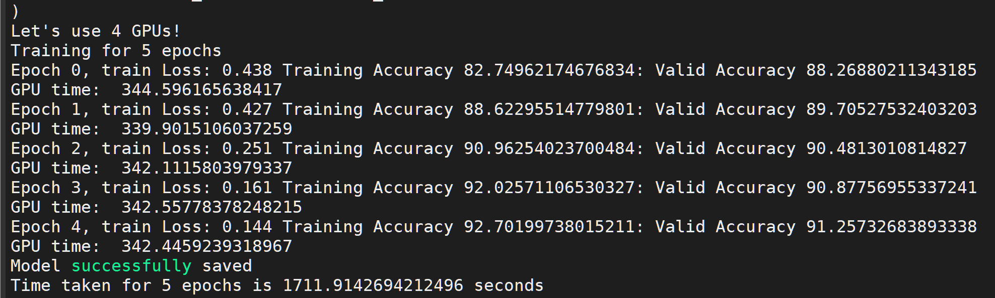
5. Data Parallelism results in Hair Feature model
On 1 GPU the time taken was the highest , 2331.72 seconds with the accuracies of 92% and 90% for training and validation respectively.
Running on 2 GPU’s I encountered the accuracies to be same as fo 1 GPU ie 92% and 90% for training and validation respectively but the total computing time reduced to 1912.40 seconds
Running on 4 GPU’s the computing time was 1711.91 seconds with training accuracy as 92% and validation accuracy og 91%

Slide 21
Part 3: Creating a GAN for generating images
The csv files for GAN’s did not require any data cleaning as the entire attribute list was used
The custom dataset and data loaders were same as that in the CNN models.
GAN’s consist of a generator and a Discriminator model whose architecture has to be designed

Slide 22
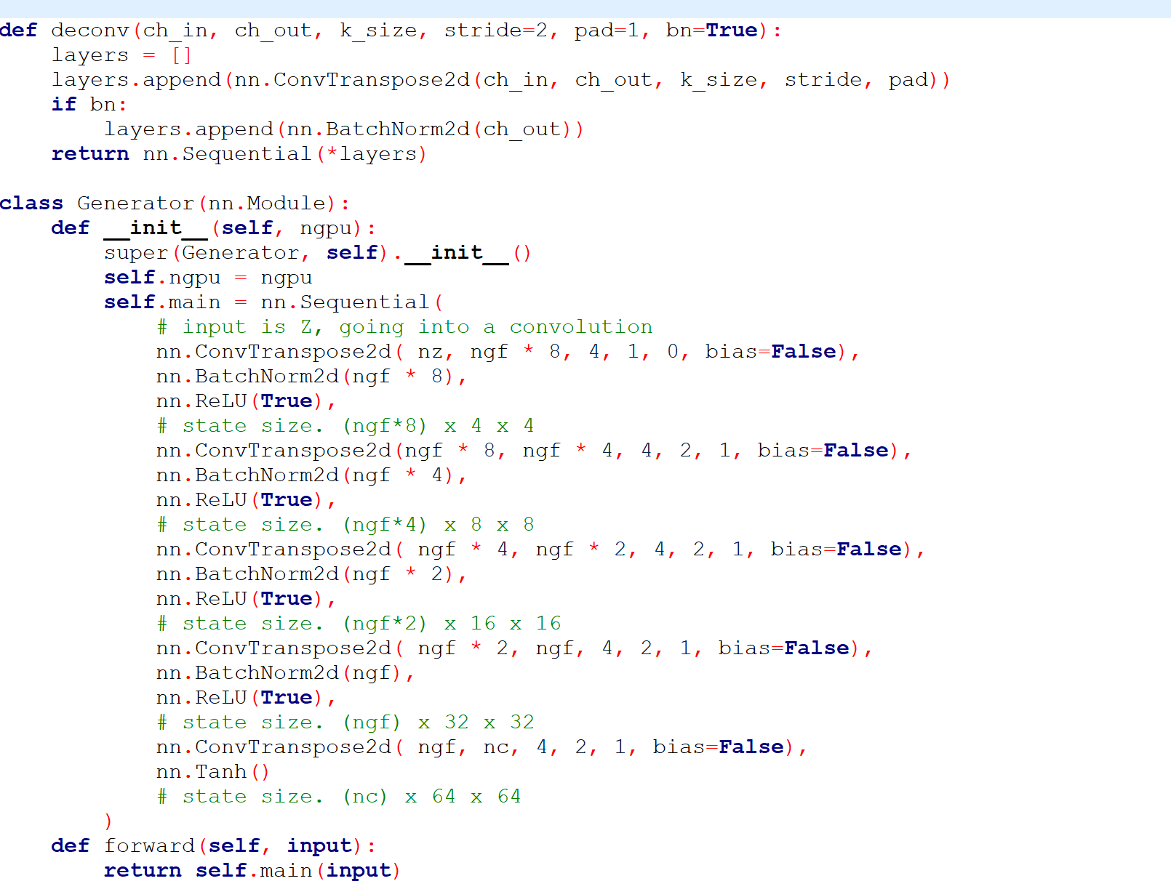
1. Creating a Generator
Generator model has an aim to generate new data similar to the original input data.
The Generator can be compared to a human art forger, who creates fake works of art.
I designed the generator model to generate fake images for the dataset of celebrities

Slide 23
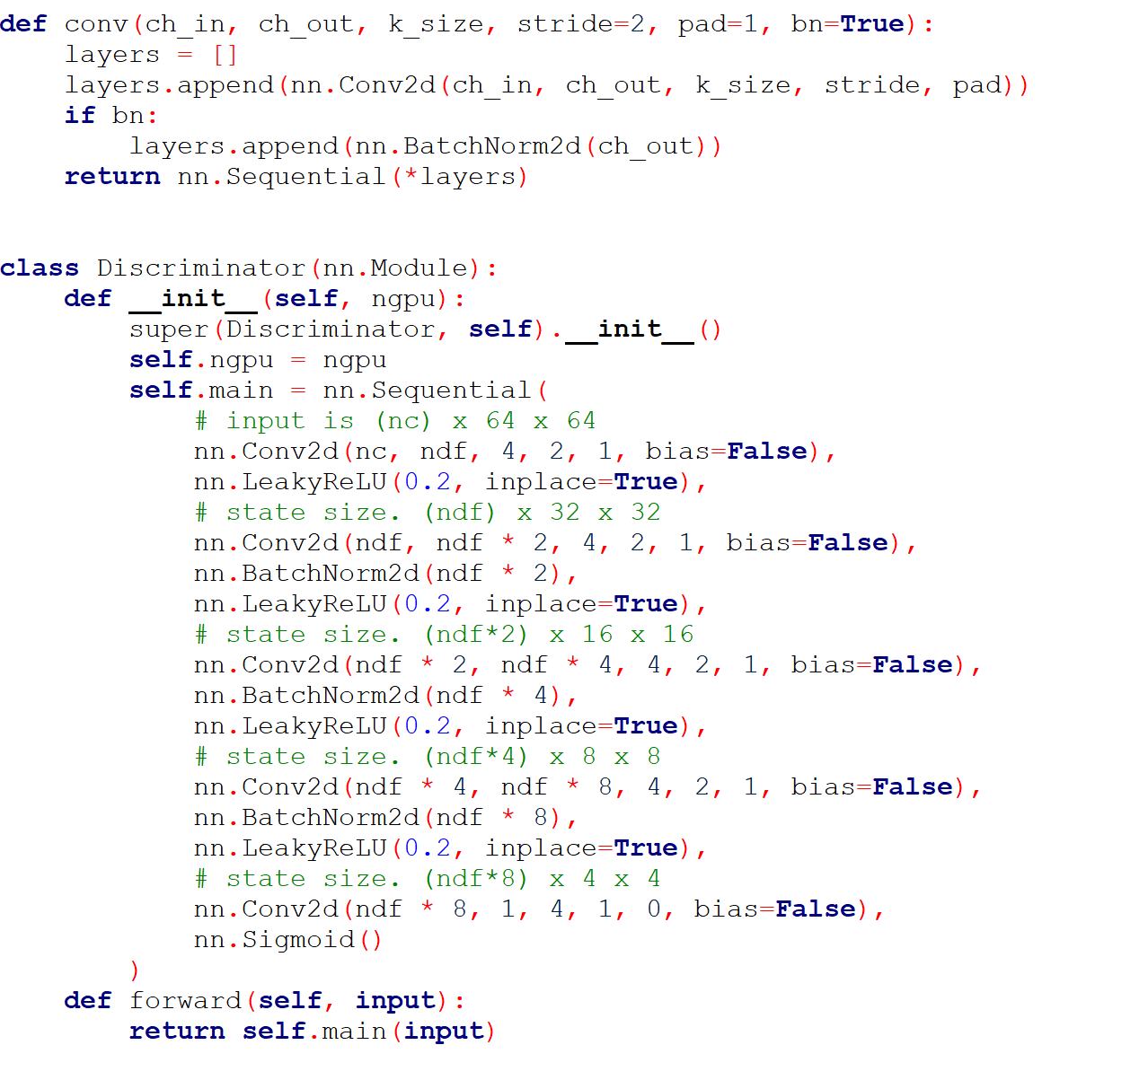
2. Creating a Discriminator
Discriminator models end goal is to identify that the input data entered is original that is the same as the original dataset or if it is the fake data that the generator has created.
The Discriminator is the same as one of the art experts, trying to predict the original and fake.
The designed discriminator model for this project was able to predict the real and fake images separately for the celebrity images of the dataset

Slide 24
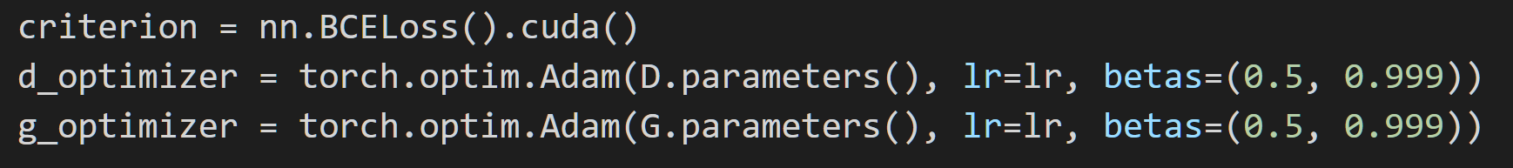
Optimizer and Cross Entropy
Binary Cross Entropy is used as the cost function as it works better with autoencoding
Adam is the optimizer used here which has an adaptive learning rate

Slide 25
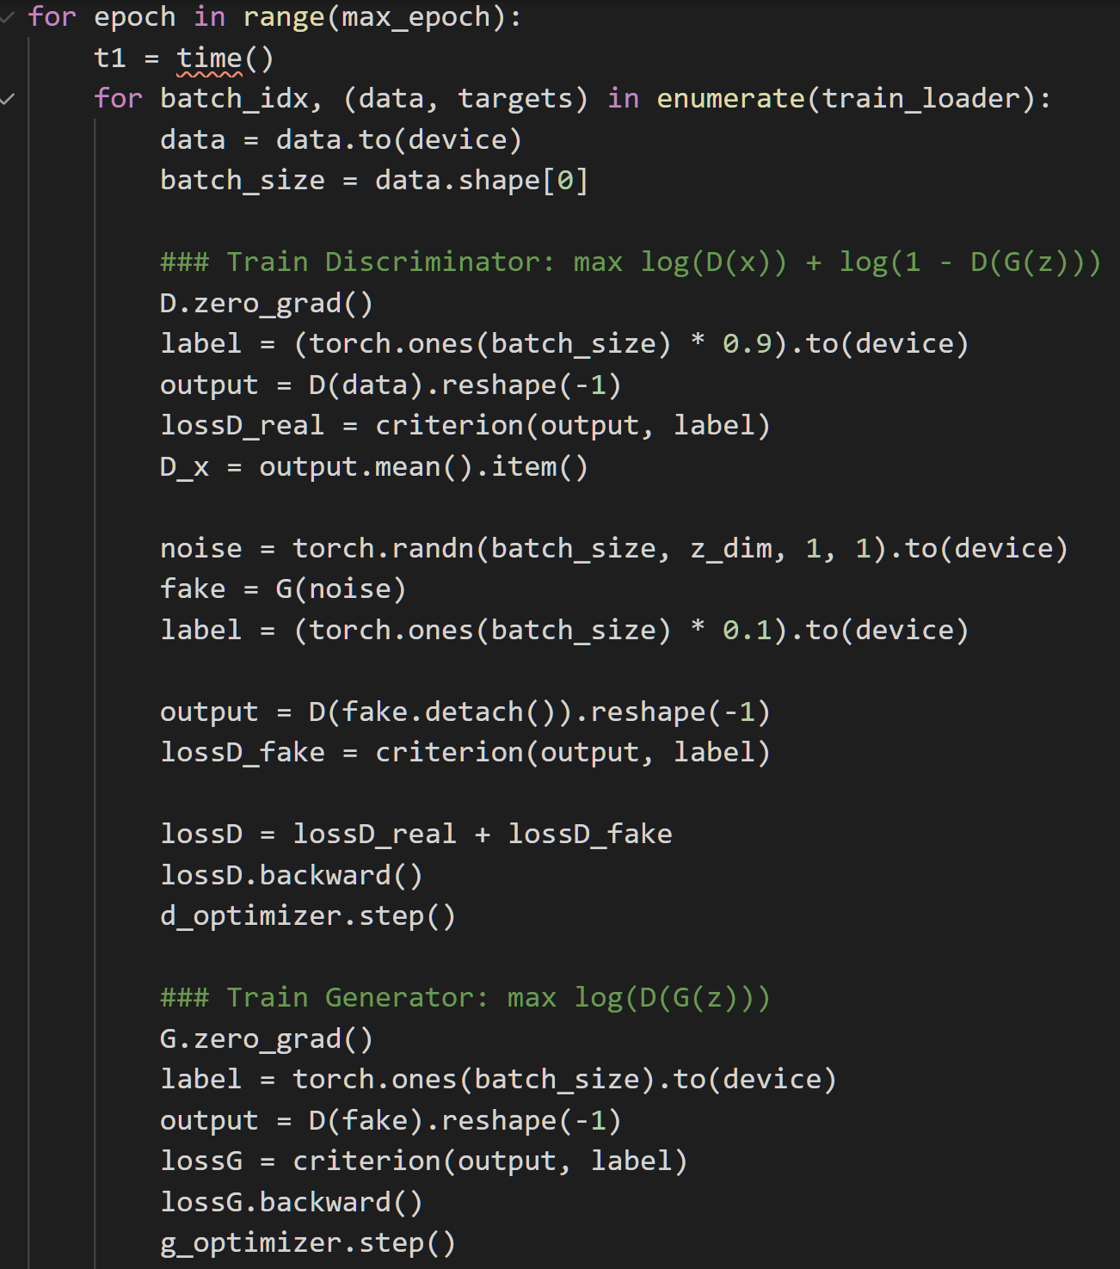
3. Training images
The discriminator is first trained to tell images apart
Noise is also introduced
The generator is trained by first setting the gradients to zero.
The generator output is then compared

Slide 26
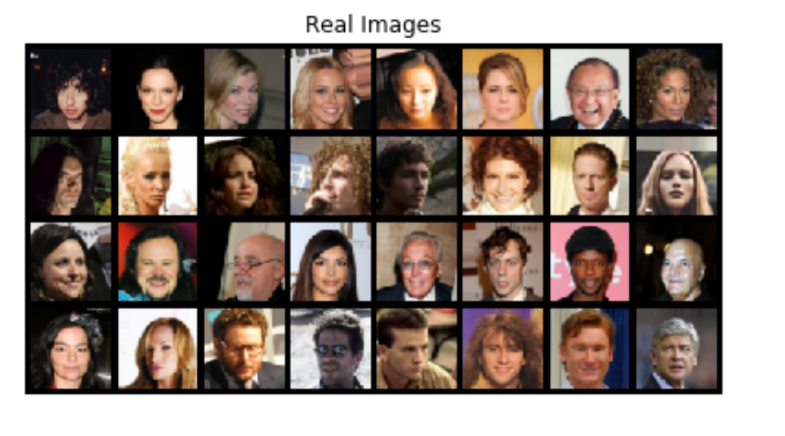
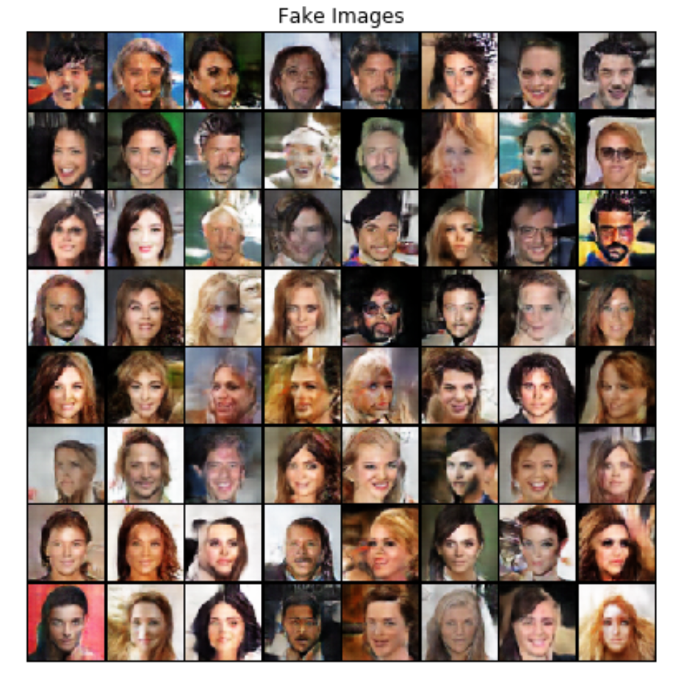
4. GAN results

Slide 27
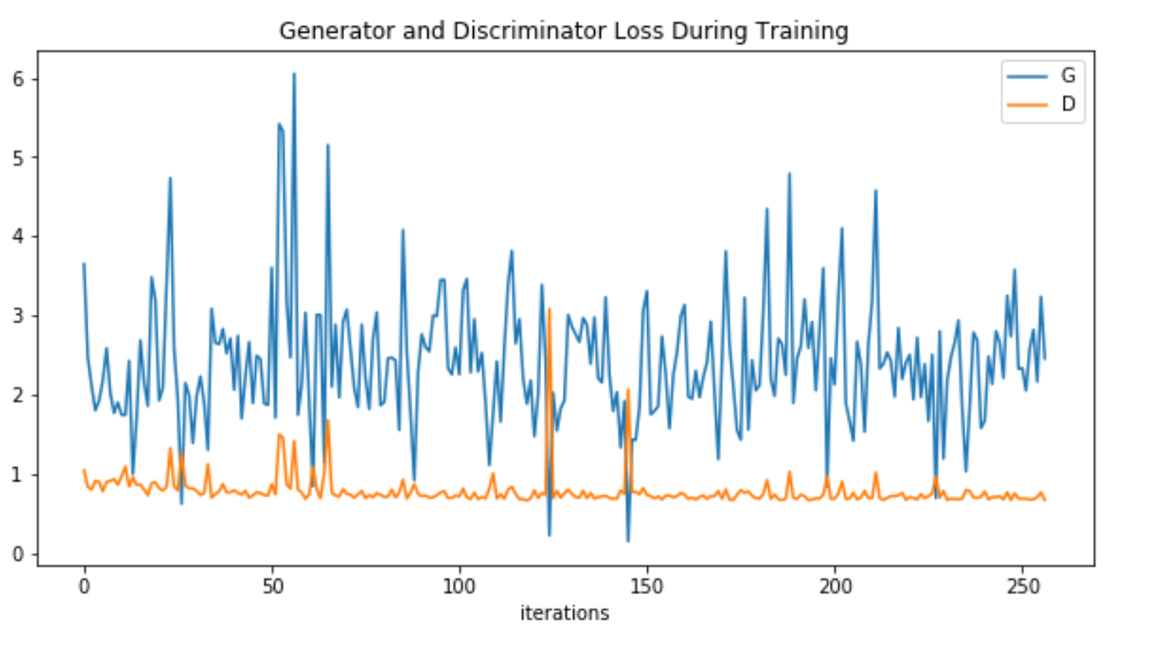
Plot Diagram of Generator and Discriminator Loss During Training In GAN Model

Slide 28
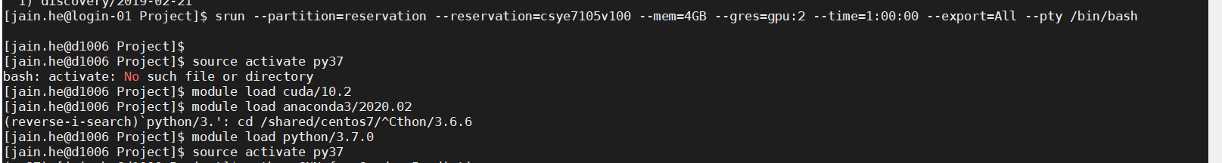
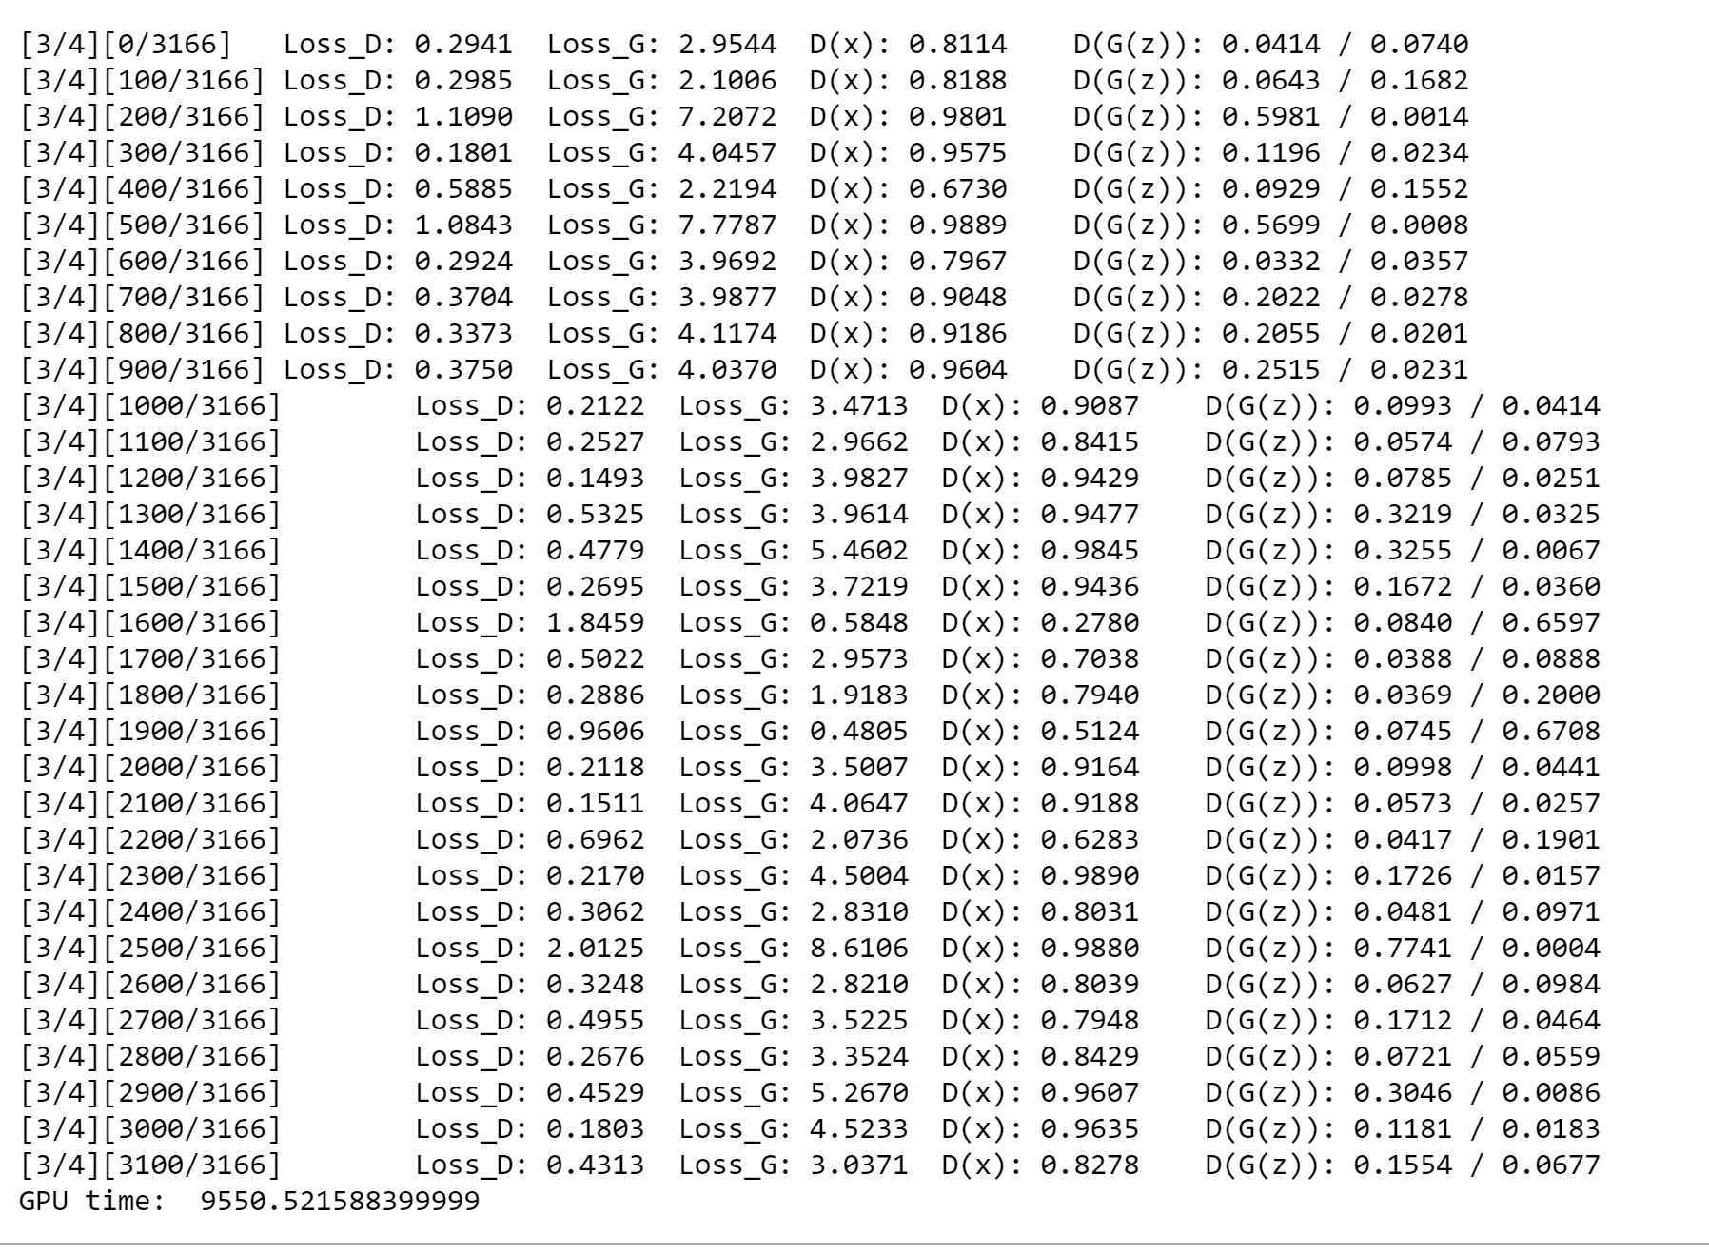
5. Data Parallelism in GAN’s
The specifications required on the discovery cluster while working with running GAN’s
Computing time on 1 GPU for each epoch was 9550 seconds and the loss for Generator and Discriminator were 3.03 and 0.4 respectively.

Slide 29
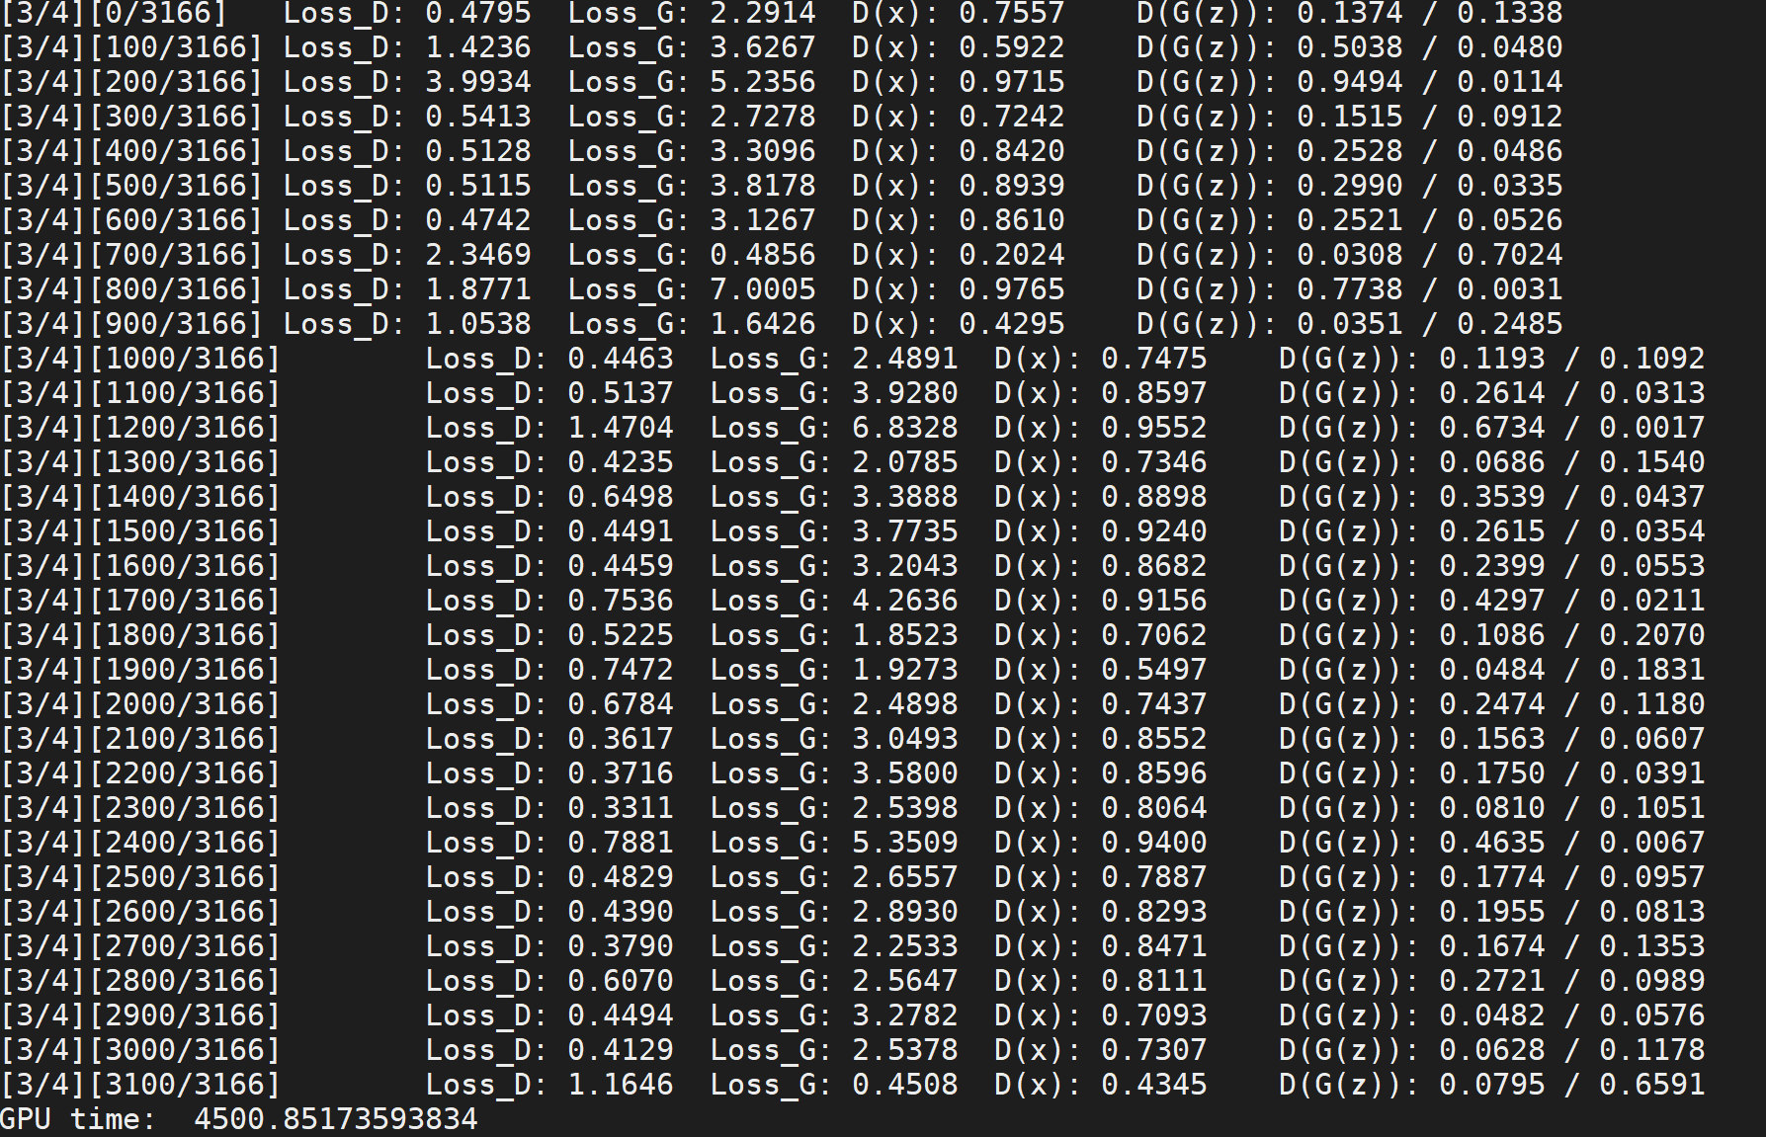
For 4 GPU’s the computing time of each epoch was 4500 seconds, half of that for 1 GPU,and the resultant loss function for Generator was 0.4 and Discriminator was 1.1

Slide 30
Part 4: Deploying a Trained ML Model in the StreamLit Web based App
This project highlights Streamlit's new hash_func feature with an app that calls on TensorFlow to generate photorealistic faces, using Nvidia's Progressive Growing of GANs and Shaobo Guan's Transparent Latent-space GAN method for tuning the output face's characteristics.
The Streamlit app is implemented in only 150 lines of Python and demonstrates the wide new range of objects that can be used safely and efficiently in Streamlit apps with hash_func.

Slide 31
Description about the Trained ML Model
Model Bias
Playing with the sliders, you will find biases that exist in this model. For example, moving the Smiling slider can turn a face from masculine to feminine or from lighter skin to darker. Apps like these that allow you to visually inspect model inputs help you find these biases so you can address them in your model before it's put into production.
How to run this demo
cd demo-face-gan
pip install -r requirements.txt
streamlit run streamlit_app.py

Slide 32
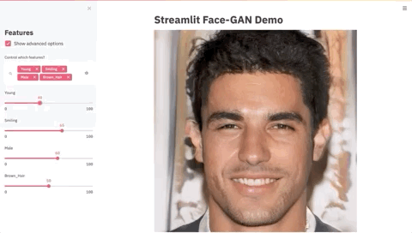
Streamlit Demo: The Controllable GAN Face Generator

Slide 33
Conclusion
Both the algorithms implemented by me worked effectively generating the desired output
The CNN could be improved by maybe using a pre-trained model or introducing other methods of regularization to ensure it doesn’t overfit the training data
The GAN’s can be improved further by maybe increasing the number of epochs, time constraints had us reduce the epochs to just 4
Additional Deployment of Fake Face Generative Embedded Machine Learning Model with Streamlit based App makes it quite interactive and real-time in utilizing the Pre-trained ML model from Nvidia for new face creation in no time

Slide 34

Thank You for your time!
Happy to answer any questions if you have in regards to my project and demo

